Slide 1
Selected Project: Predicting Movie Success
Predicting Movie Success

Slide 2


Predicting Movie
Success Analysis
“This project aims to predict movie success categories using machine learning models based on IMDB scores.
It involves extensive exploratory data analysis (EDA) to uncover key factors influencing success.
Experiment with different classification algorithms to identify the most effective model.”
Presented By : Reshma Pandit

Slide 3
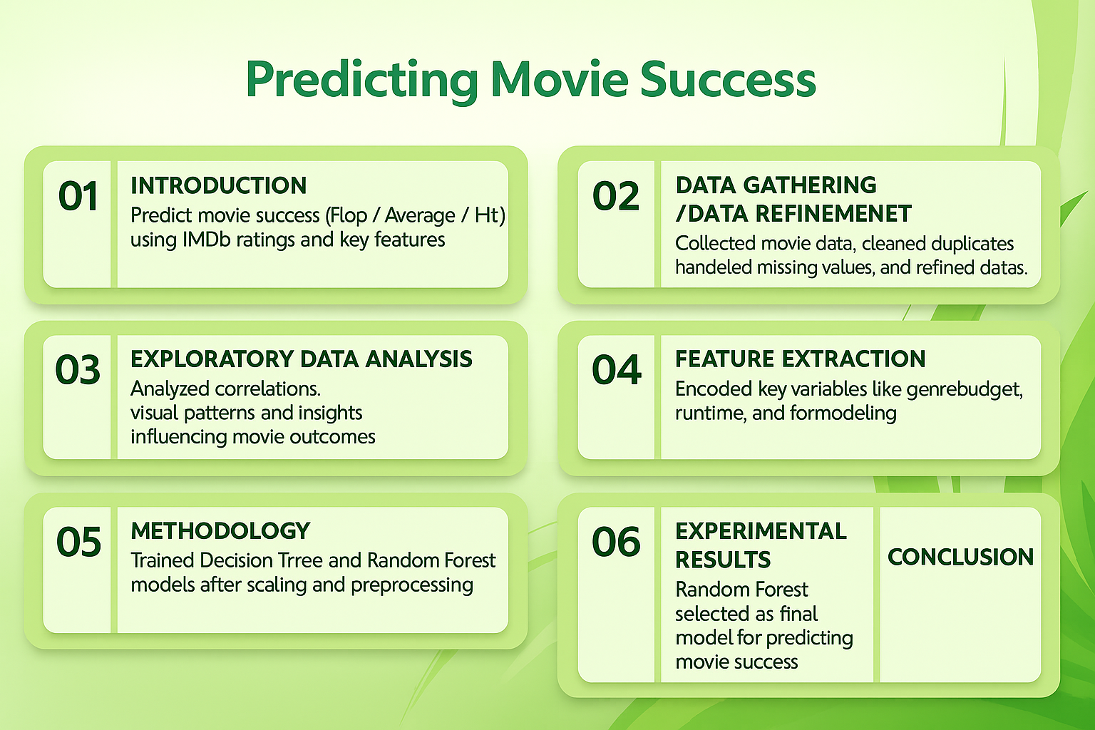
Title

Slide 4
INTRODUCTION
Focus on Predicting success level of movies -> Flop, Average or Hit on IMDB ratings.
First, we cleaned the raw data by fixing missing information and making everything neat and usable.
Then we looked for patterns to understand what makes a movie Flop, Average, or Hit.
We used two ML models — Decision Tree and Random Forest — to predict how successful a movie might be.
Finally, the outcome. helps producers and investors guess a movie’s performance before it releases, so they can make better choices.

Slide 5
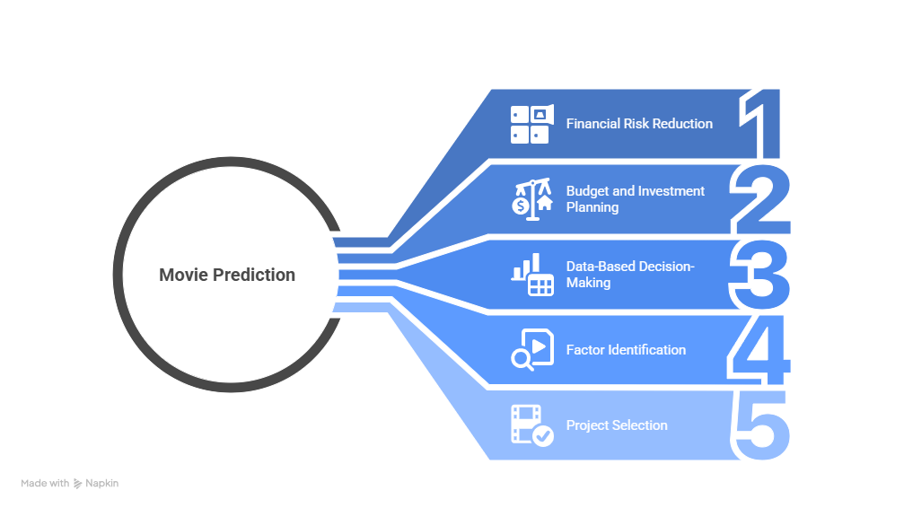
Objective OF The Study

Slide 6
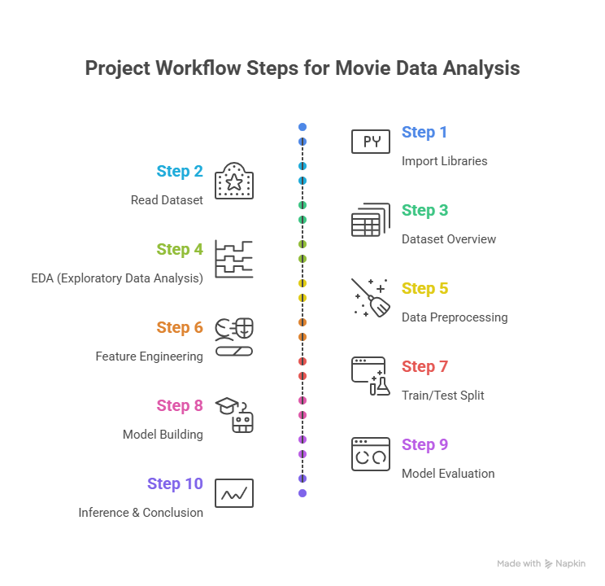

Slide 7
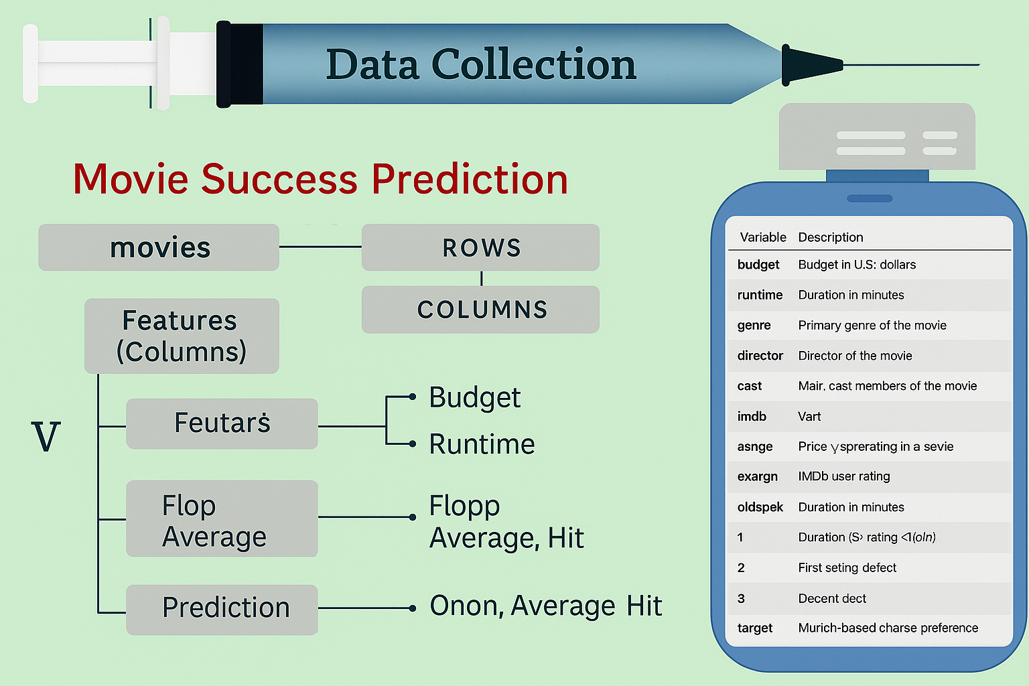

Slide 8
📊 EXPLORATORY DATA ANALYSIS (EDA)
Analyzed individual features (IMDb score, budget, gross) to study distributions and detect outliers.
Identified common patterns — popular genres, languages, and production countries.
Explored relationships between movie features and success categories (Flop, Average, Hit).
Gained insights into key factors influencing movie success for better model preparation.

Slide 9
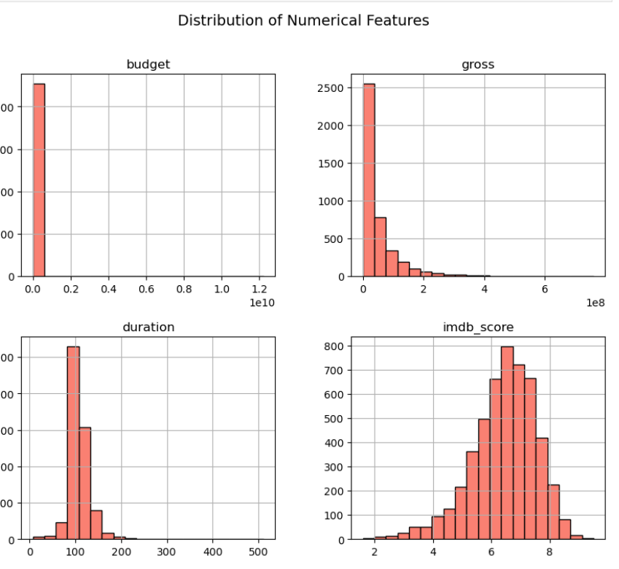
DISTRIBUTION OF CONTINUOUS VARIABLE
For continuous data: I am going to use colum plots to showcase the average value of each numeric feature
(such as Budget, Gross, Duration, and IMDb Score) for the different target classes, and box plots to understand the distribution of each feature across the target classes.
This helps identify how continuous variables differ between successful (Hit) and unsuccessful (Flop) movies.

Slide 10
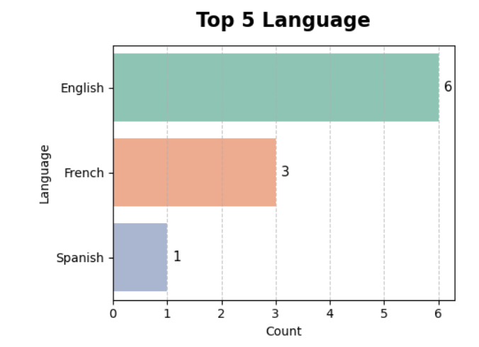
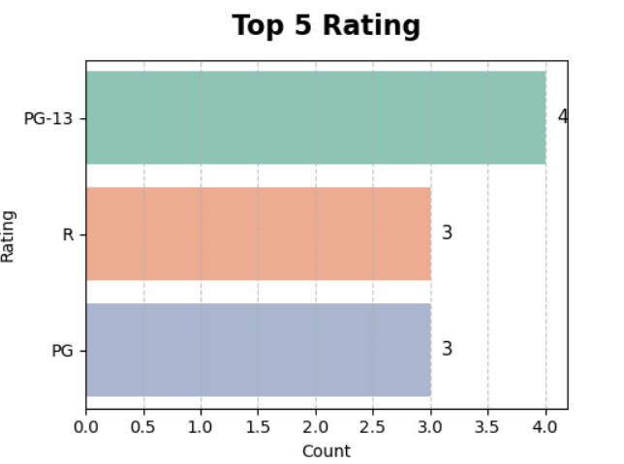
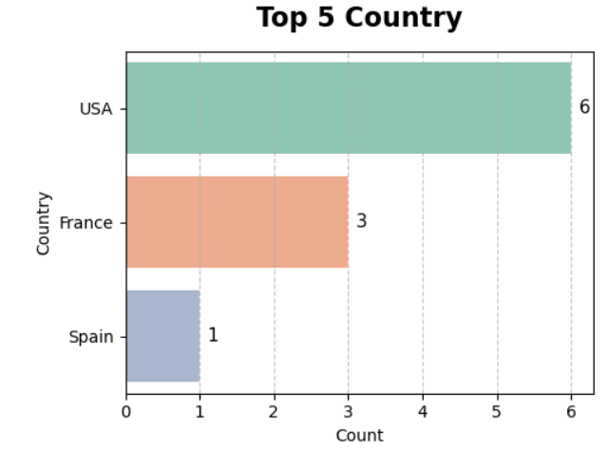
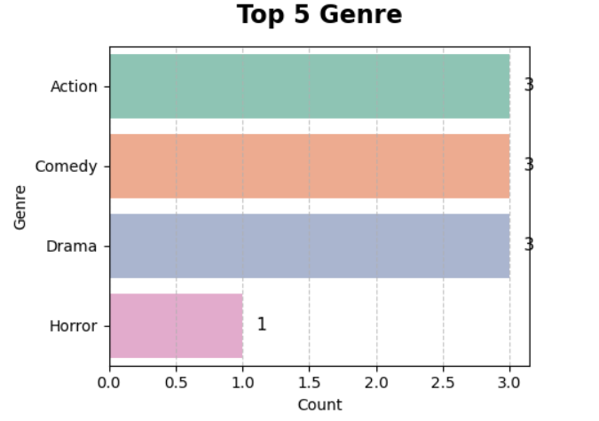
DISTRIBUTION OF Categorical Features
The distribution of categorical variables helps us understand how different categories (like Genre, Language, Country, or Rating) are spread across the dataset.
It shows which categories are most frequent or dominant, revealing patterns such as the most common movie genres or languages.
By analyzing these distributions using bar charts or count plots, we can identify trends that may influence movie success levels — for example, which genres often result in Hit or Flop movies.
Summary :
Higher Impact : Genre, Rating
Moderate Impact on Target : Country
Lower Impact on Target: Language

Slide 11
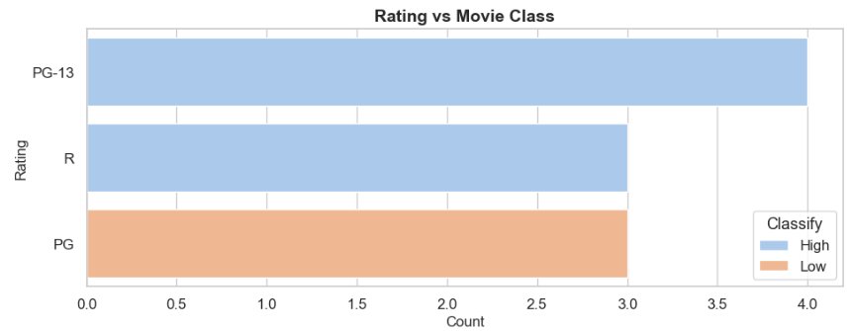
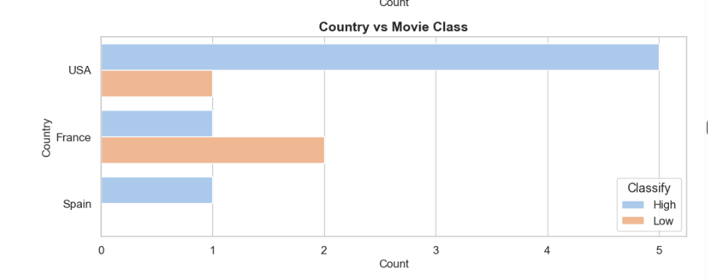
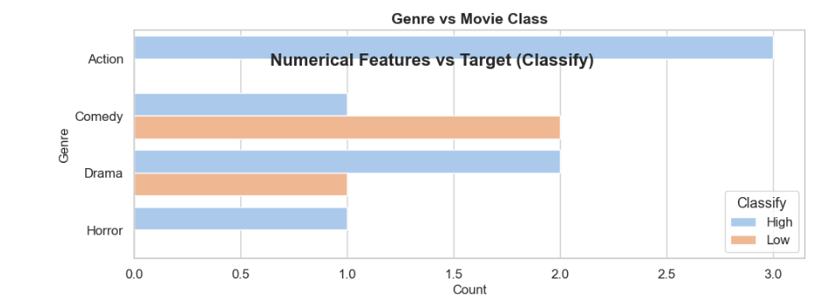
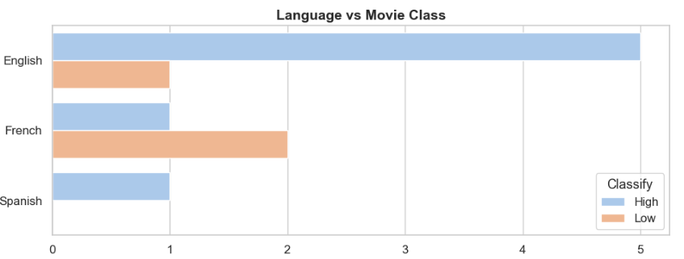
Numerical Features Vs Target
I am going to visualize each numerical feature against the target (Classify – Flop, Average, Hit) using two types of charts:
Bar plots – showing the average value of each numeric feature (Budget, Gross, Duration, IMDb Score, Number of Critic Reviews, Number of User Reviews) for each target class.
KDE plots – displaying the distribution of each numeric feature across the target categories.
Summary :
Higher Impact : Rating vs movie class, genre vs movie class
Moderate Impact on Target : country vs movie class
Lower Impact on Target: Language vs movie class

Slide 12
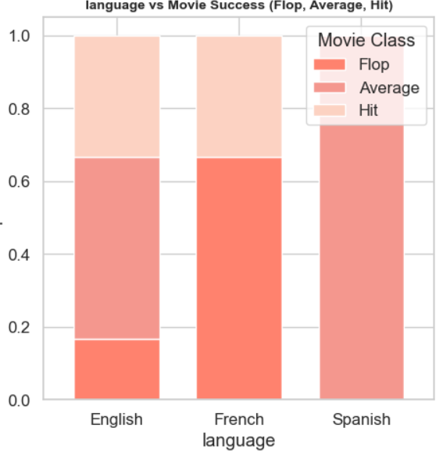
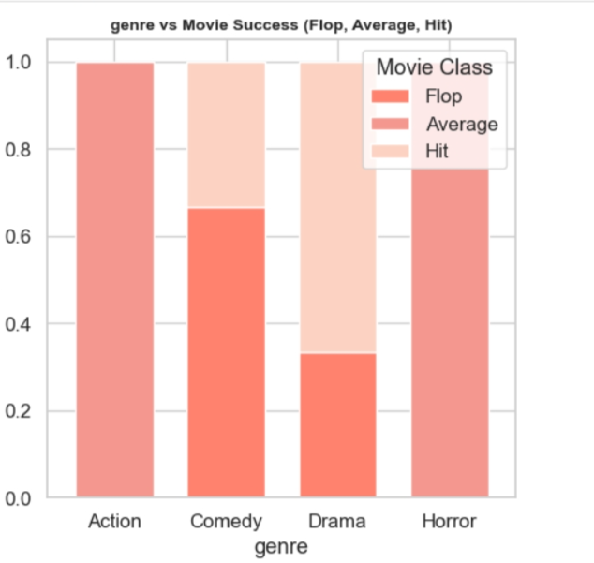
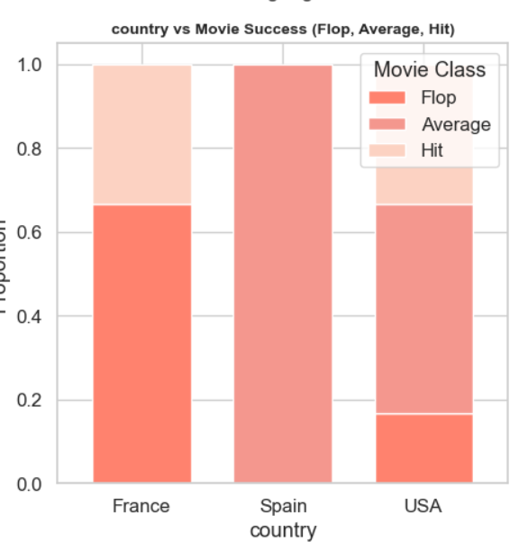
Categorical Features Vs Target
Higher Impact on Target:
Genre: Drama and Adventure have more Hits; Action and Horror see more Flops.
Language: English and Hindi movies perform better; wider audience reach increases success.
Moderate Impact on Target:
Country: USA and India dominate; USA shows more Hit movies overall.
Lower Impact on Target:
Rating: PG-13 and R movies perform slightly better; audience maturity has some influence.

Slide 13
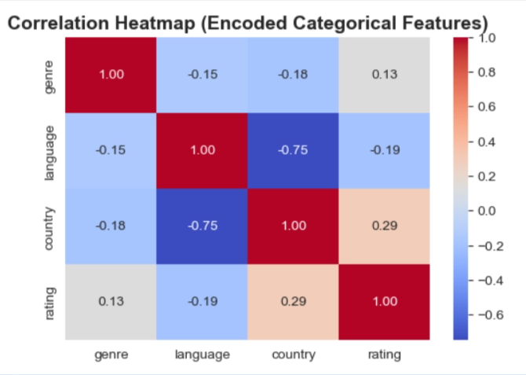
Correlation & Heatmap
High Positive Correlation on Target: genre
Moderate Positive Correlation on Target:
language
Low Correlation on Target: country.

Slide 14
PREPROCESSSING
All features in the dataset appear to be relevant based on our __EDA__.
No columns seem redundant or irrelevant.
Thus, we'll retain all features, ensuring no valuable information is lost,
especially given the dataset's small size

Slide 15
TRAIN TEST SPLIT We split the data into 80% training and 20% testing to make sure the model learns patterns correctly and is tested fairly on unseen data to avoid overfitting.
SPLITING THE DATA INTO X & Y
We divided the dataset into two parts: X and y.
"X" typically represents the independent Variables, and "y" represents the Dependent (target variable) that we want to predict or understand.

Slide 16
Model Building
¶
Build, train and evaluate classification models (e.g., Random Forest)
to predict movie performance (Hit/Average/Flop)
using engineered features, with performance metrics and visualizations.

Slide 17
Model Evaluation
After building and training both models — Decision Tree and Random Forest — the next step is to evaluate their performance.
In this stage, we test how well each model predicts unseen data using key performance metrics like Accuracy, F1-Score, and Recall.
We also visualize results through Confusion Matrices and Classification Reports,
then compare both models to identify which one performs better and generalizes best to new data.

Slide 18
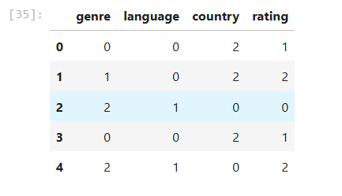
Categorical Encoding one-hot encoding)
✅ Summary: All text-based categorical columns have been successfully converted into numeric codes using Label Encoding. This ensures that machine learning models can now easily understand and process these features for prediction.

Slide 19
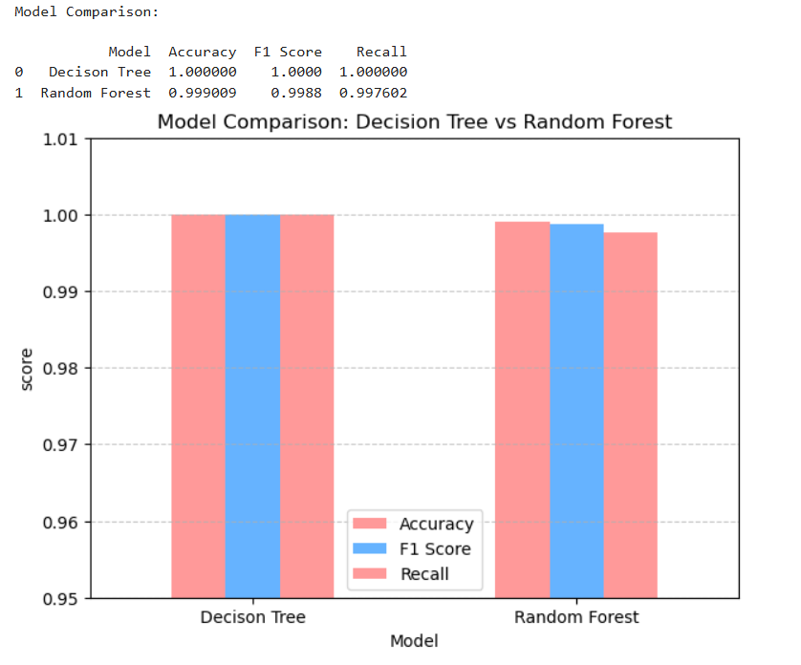
Compare models (Decision Tree vs Random Forest)
Both Decision Tree and Random Forest performed exceptionally well with almost identical results.
However, the Random Forest model is preferred as the final choice because it provides.
better stability and generalization across unseen data, while the Decision Tree may overfit slightly to training data.

Slide 20
Conclusion
🔍 Key Findings
Random Forest performed best with high accuracy in predicting movie success.
IMDb Score and Gross Earnings are the strongest predictors of hit movies.
⚠️ Limitations
Limited dataset and missing external factors may affect prediction accuracy.
Some important features like marketing or audience sentiment were not included.
🚀 Future Research
Add social media sentiment and critic reviews for deeper insights.
Use larger datasets and advanced models for better generalization.

Slide 21


Slide 22
Thank You!

